Slide 1
WEEK 3
LINUX LOGS, SYSMON,
AUDITD & SNORT
SOC Internship — Weekly Learning & Practical Report
6 November 2026

Slide 2
1. Week 3 Objectives
Understand how endpoint and Linux systems generate security logs.
Learn how SOC analysts use logs to investigate suspicious activity.
Explore Sysmon, auditd and Snort detection capabilities.
Practice alert investigation, triage and incident-response concepts.
Document findings clearly with evidence and a concise technical report.
WEEK 3 | SOC INTERNSHIP 2

Slide 3
2. Logging in a SOC Environment
Logs record events produced by operating systems, applications and security tools.
Endpoint logs can show logons, process execution, file activity and network connections.
Linux system logs help investigate authentication, service and command activity.
A SIEM centralizes, normalizes, searches and correlates events from multiple sources.
Analysts use timestamps, usernames, hostnames, process names and source IPs to build a timeline.
WEEK 3 | SOC INTERNSHIP 3

Slide 4
3. Sysmon — Windows Telemetry
Concepts studied; hands-on status is stated accurately.
Sysmon is a Windows system service and driver that records detailed system activity.
Event ID 1: Process creation.
Event ID 3: Network connection (depends on the Sysmon configuration).
Event ID 11: File creation.
These event IDs are useful investigation references; the Sysmon installation and event-generation practical was skipped this week.
WEEK 3 | SOC INTERNSHIP 4

Slide 5
4. auditd — Linux Auditing
Ubuntu practical: audit search output was reviewed.
auditd records selected security-relevant activity on Linux systems.
Audit rules can monitor command execution and changes to sensitive files.
ausearch can retrieve and interpret records using an audit rule key.
A sample record showed comm=ausearch, exe=/usr/sbin/ausearch and key=command_execution.
The record showed success=yes and auid=rajdeep; this was an example of command execution, not proof of malicious activity.
WEEK 3 | SOC INTERNSHIP 5

Slide 6
5. Reading an audit Event
Example fields from the audit output reviewed during the practical.
type=EXECVE: records the command and its arguments.
type=SYSCALL: records the system call result and process details.
type=CWD: records the working directory at the time of the event.
auid: original login identity; uid/euid: user identity used for the operation.
pid/ppid: process and parent-process identifiers; exe: executable path.
success=yes: indicates the audited system call succeeded.
WEEK 3 | SOC INTERNSHIP 6

Slide 7
6. Snort — Network Intrusion Detection
Detection concepts reviewed; no deployed/tested Snort alert is claimed.
Snort is a network intrusion detection/prevention tool that inspects traffic using rules.
A rule can match protocol, addresses, ports and packet content, then generate an alert.
An Nmap SYN scan can be investigated as possible network-service discovery.
MITRE ATT&CK technique T1046 describes Network Service Discovery.
Snort installation and alert testing were skipped because the package was unavailable in the configured Ubuntu 26.04 repositories.
WEEK 3 | SOC INTERNSHIP 7

Slide 8
7. LetsDefend Learning
How to Investigate a SIEM Alert — completion was explicitly confirmed.
Security Solutions — writeup prepared; completion evidence not confirmed.
Network Log Analysis — writeup prepared; completion evidence not confirmed.
SIEM 101 — writeup prepared; completion evidence not confirmed.
Incident Management — writeup prepared; completion evidence not confirmed.
Incident Response on Linux — writeup prepared; completion evidence not confirmed.
WEEK 3 | SOC INTERNSHIP 8

Slide 9
8. TryHackMe Learning & Writeups
Linux Logging for SOC
Intro to Logs
Intro to Log Analysis
Snort
Separate study writeups/templates were prepared for these rooms.
Room completion and room-specific answers must be verified and supported with genuine screenshots before submission.
WEEK 3 | SOC INTERNSHIP 9

Slide 10
9. Week 3 Progress Summary
Completed/reviewed: auditd search output and interpretation of key event fields.
Confirmed training completion: LetsDefend — How to Investigate a SIEM Alert.
Prepared: theory notes, event ID cheat sheet, Snort rule cheat sheet, learning writeups and README.
Skipped: Sysmon practical.
Skipped: Snort installation and alert testing due to package availability issue.
Evidence still needed: practical screenshots and verified completion screenshots for remaining learning activities.
WEEK 3 | SOC INTERNSHIP 10

Slide 11
10. Key SOC Analyst Takeaways
Do not judge an event from one field; correlate user, host, process, time and network context.
A successful command execution is not automatically suspicious.
Use audit keys and SIEM filters to narrow investigations efficiently.
Treat IDS alerts as leads that require validation, not as proof of compromise.
Document what was actually tested, what was observed and what remains incomplete.
WEEK 3 | SOC INTERNSHIP 11

Slide 12
11. Submission Checklist
Add genuine screenshots to the Findings folder.
Verify each TryHackMe room and LetsDefend lesson; attach completion evidence.
Keep each lesson/room writeup as a separate file.
Include the event ID and Snort rule cheat sheets.
Include the PDF report, this presentation and the README.
Review the folder structure and submit the Google Drive link as instructed.
WEEK 3 | SOC INTERNSHIP 12

Slide 13
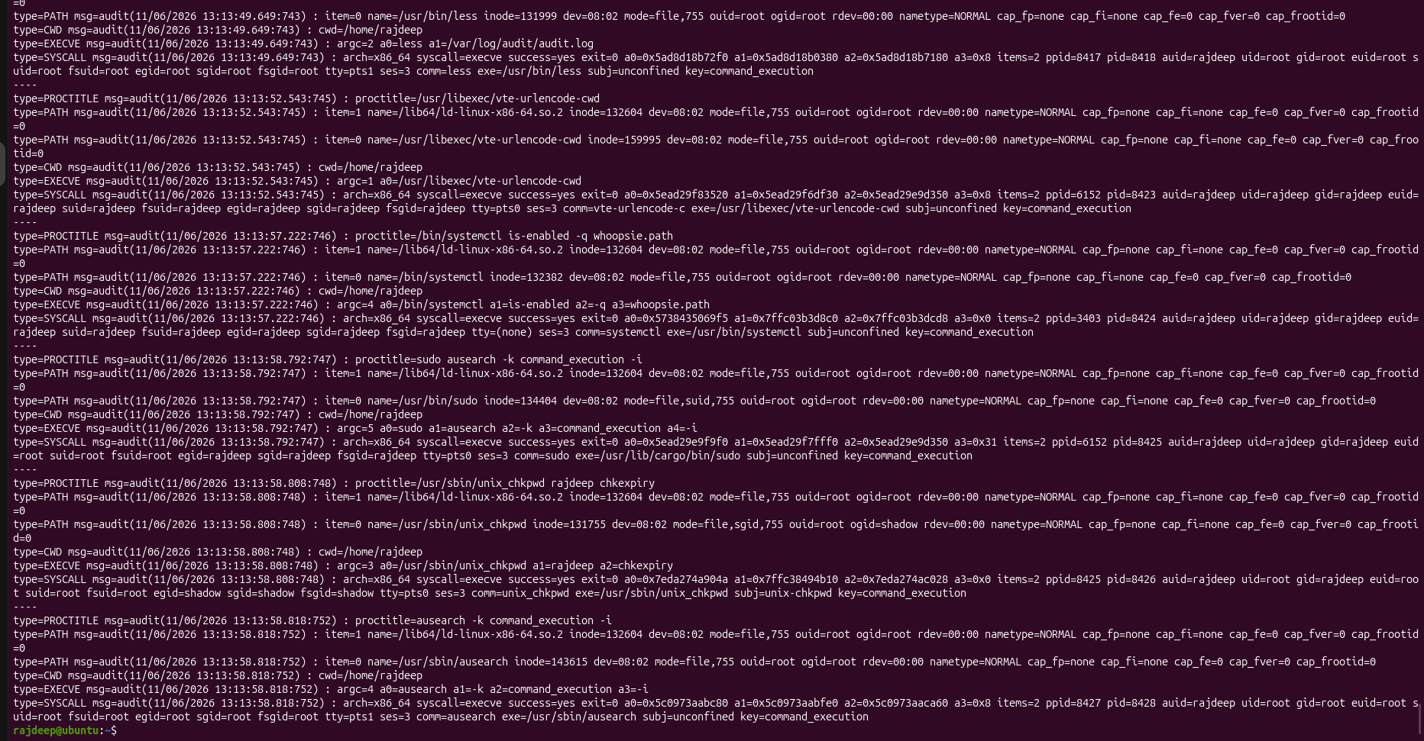
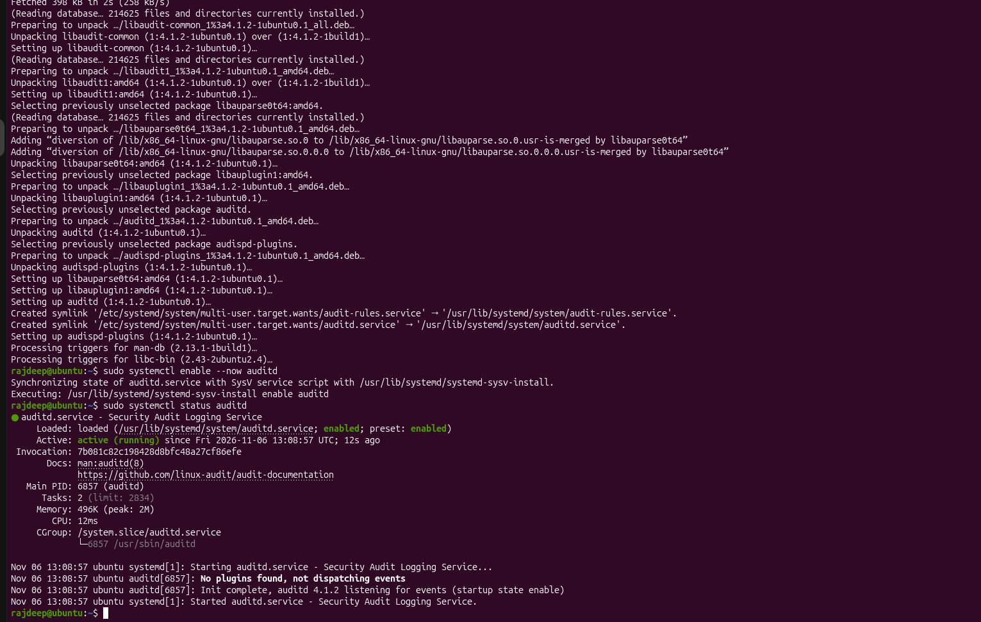
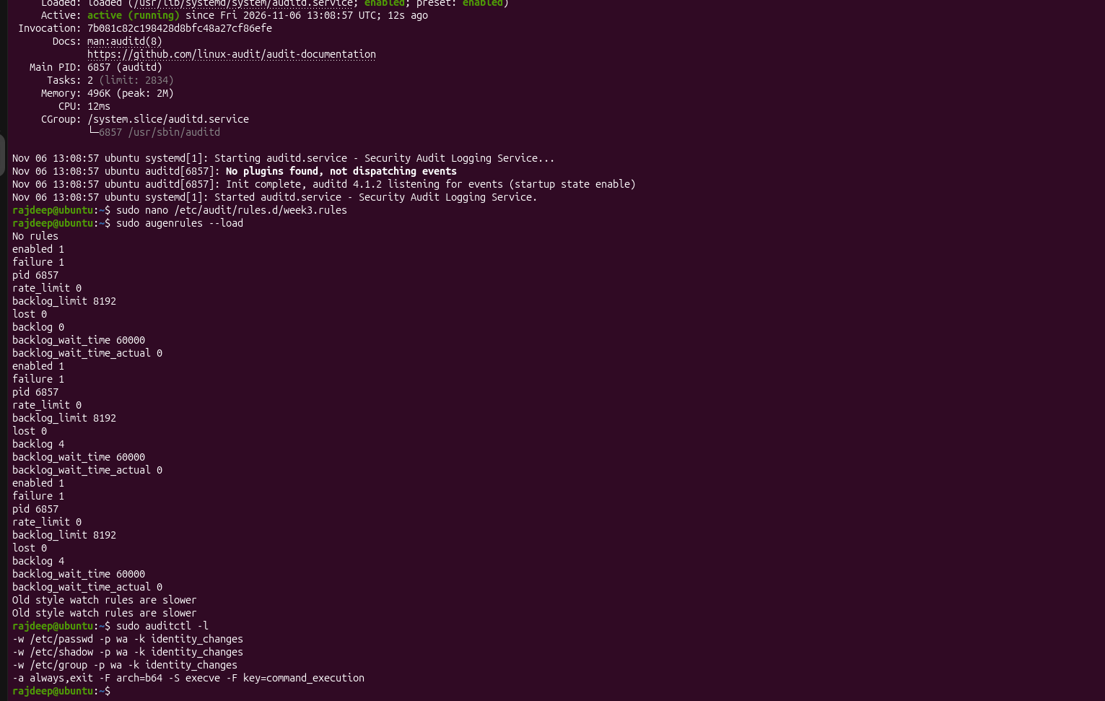
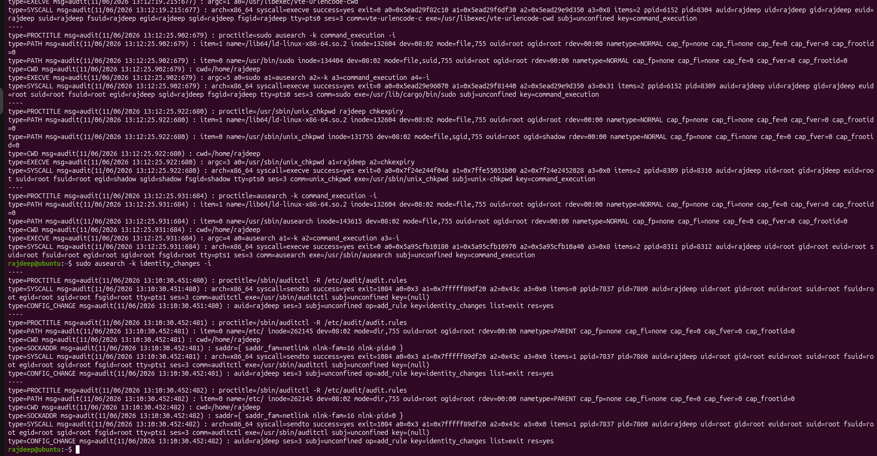

Slide 14
THANK YOU
Week 3 — SOC Internship

